Slide 1

Application website for FLIPKART

Slide 2

AIM :- TO ANALYSE e-commerce application for FLIPKART.

Slide 3
Requirements
LOGIN MODULE
2.USER NAME (E –MAIL or PHONE NUMBER)
3.PASSWORD
4.WEBSITE(www.FLIPKART.in)

Slide 4
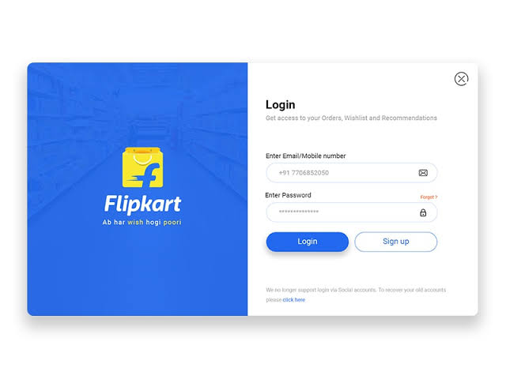
FLIPKART login page

Slide 5
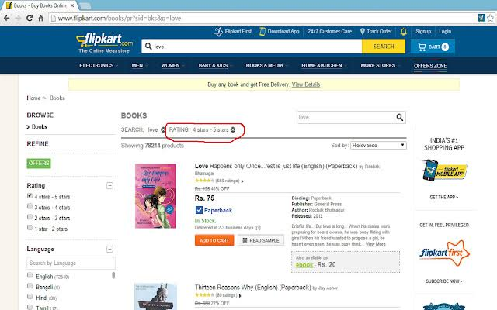
Searching page

Slide 6
POSITIVE TEST SCENARIO
Enter Valid email or mobile number.
Enter Valid Password.
Click on “Forgot Password” Link and find out forgot password page.
Click on Create new account button and verify if it takes to new account page.
Select “Keep me signed in” option to retain login session
Select “Help” option to get help from amazon.
Select “Privacy Note” to get amazon privacy polices page.
In Forgot page –Enter the OTP(One Time Password) to recreate the amazon password.
Clicking on the “product image” .It directly takes to the product page.
Clicking on the “Buy Now “ link Button. It directly takes to the payment page.

Slide 7
Negative test scenario
Enter invalid username and valid password.
Enter valid username and invalid password.
Enter invalid username and password.
Keep one field blank either username or password and check login.
The price on the image and the on the product was mostly different.
The payment declaim was high in the amazon pages.
Need to improve the return and replacement options.
Need to improve the UI(USER INTERFACE) on the web site.
When the network was slow the was buffer on that time.
On searching one product It shows different products

Slide 8
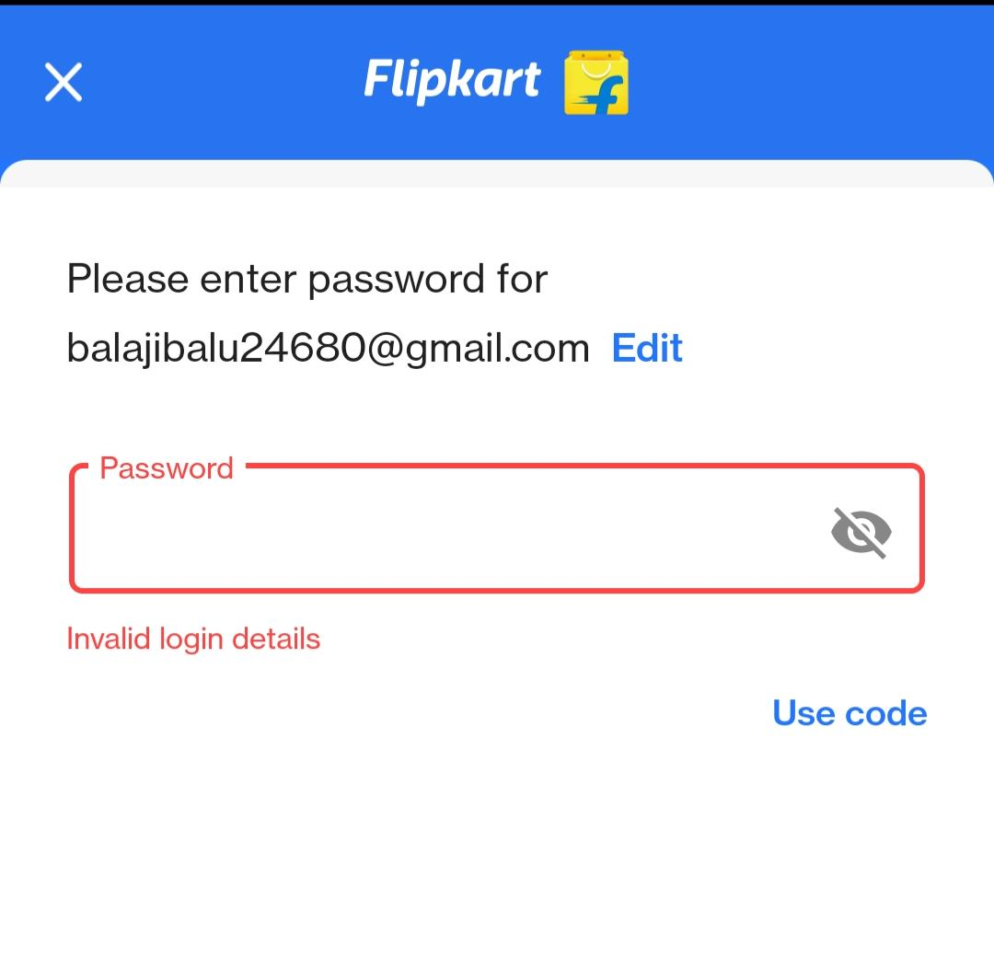
Enter valid user name and invalid password

Slide 9
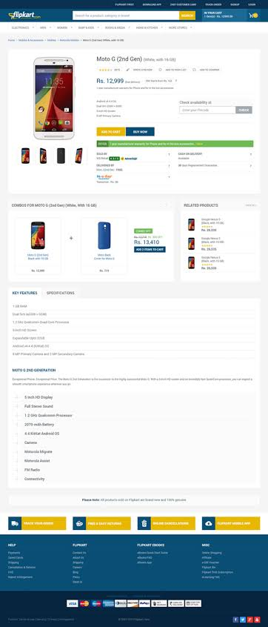
Product difference in Image and product page

Slide 10
TEST CASES
Test cases | Type – negative/positive
Verify if a user will be able to login with valid username and valid password. | Positive
Verify if user is able to login with a new password only after he has changed the password. | Positive
Verify if the data in password field is either visible as asterisk bullet signs. | Positive
Verify the forget password functionality. | Positive
Verify the messages for invalid login. | Positive
Verify the not remember me functionality. | Negative
Verify the login page for both ,when the field is blank and submit button is clicked. | Negative
Verify if a user cannot login with a valid username and an invalid password. | Negative
Verify if user able to identify the price difference in image and the product page | Negative
Verify if user search for product and it does not show the product | Negative

Slide 11
conclusion
I have navigate the FLIPKART web application and find out the positive / pass and negative / fail test cases. This is to improve the application performance in better manner.

Slide 12


